Slide 1
Introduction to Greek Philosophy
Prepared by
Dr. Anosh Narzary
Asst. Prof. Dept. of Philosophy
Bengtol College, Bengtol

Slide 2
Introduction to Greek Philosophy
GREEK PHILOSOPHY
Ancient Greek philosophy arose in the 6th BC
Philosophy was used to make sense of the world using reason. It dealt with a wide variety of subjects, including astronomy, epistemology, mathematics, political philosophy, ethics, metaphysics, ontology, logic, biology, rhetoric and aesthetics.

Slide 3
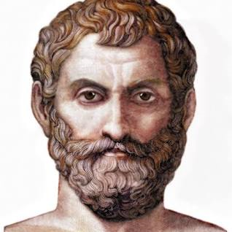
Thales (Greek Philosopher)

Slide 4
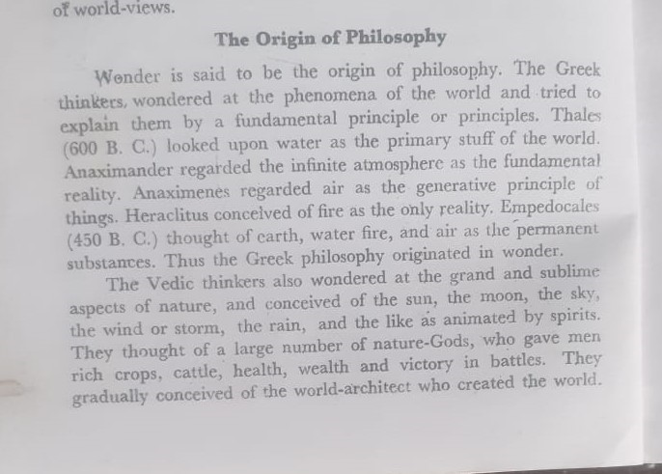
Origin of Greek Philosophy

Slide 5
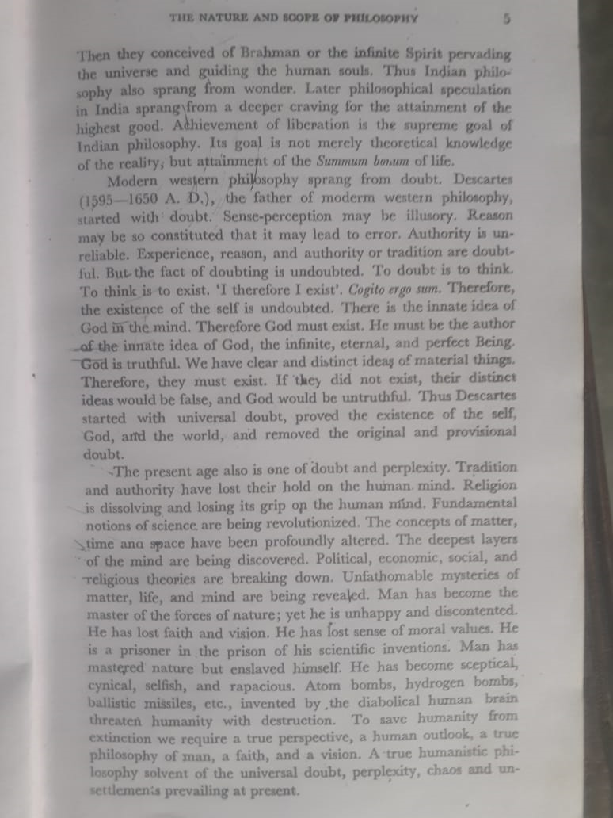

Slide 7
Pythagoras was an ancient Greek philosopher and mathematician, best known for his contributions to geometry and for the Pythagorean theorem, which is named after him.
He is one of the most famous and influential mathematicians and thinkers of ancient Greece.

Slide 8
Democritus was an ancient Greek philosopher born around 460 BCE in Abdera, Thrace (in modern-day Greece). He is best known for his contributions to the development of atomism, a philosophical theory that posits that the universe is composed of indivisible, fundamental particles called "atoms.“
Democritus and his mentor Leucippus are often credited with the development of this concept, although many of their writings have been lost, and much of what we know about their ideas comes from later philosophers and commentators.

Slide 9


